Slide 1

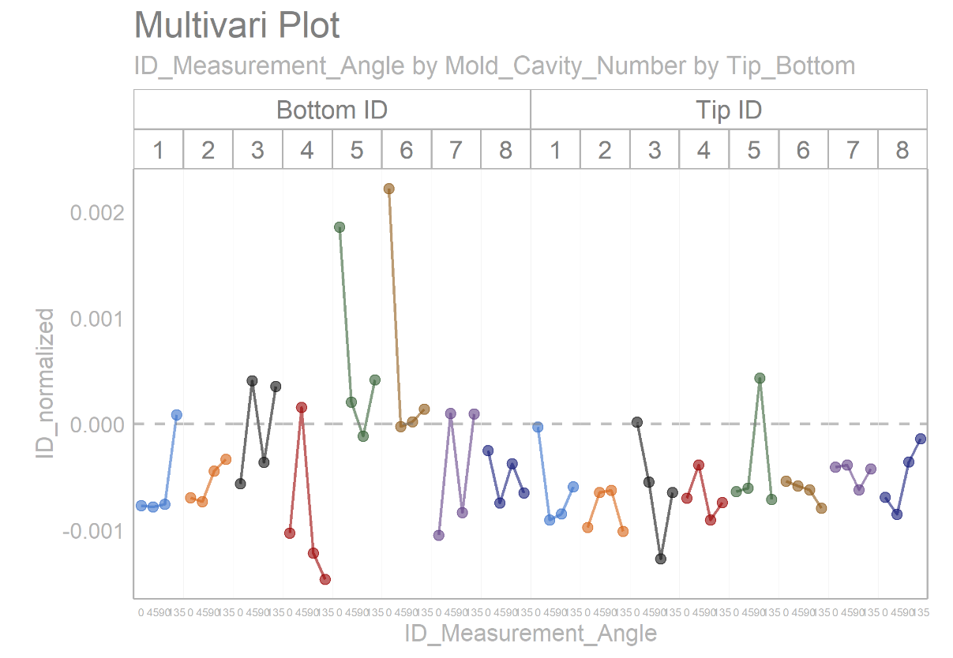
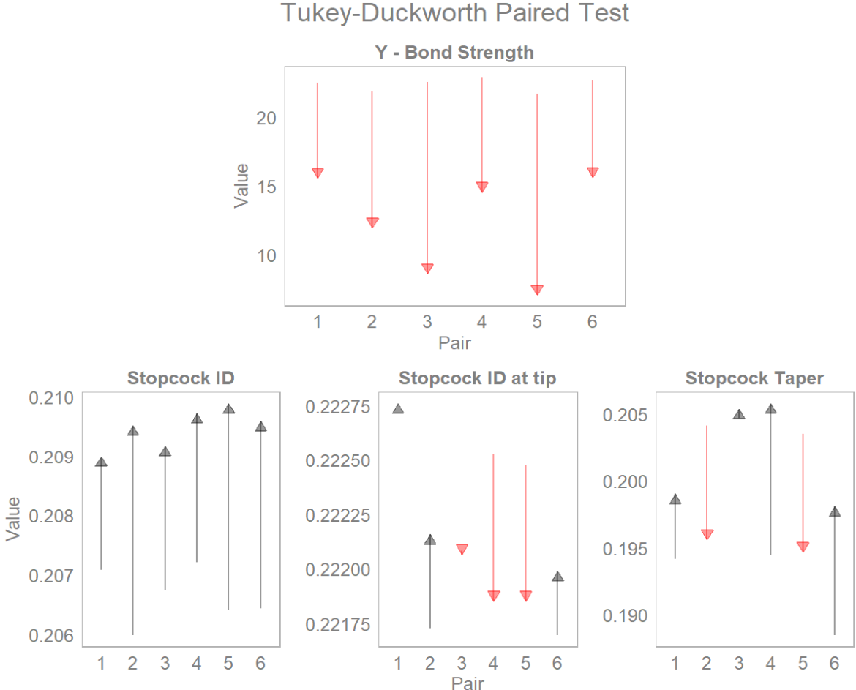
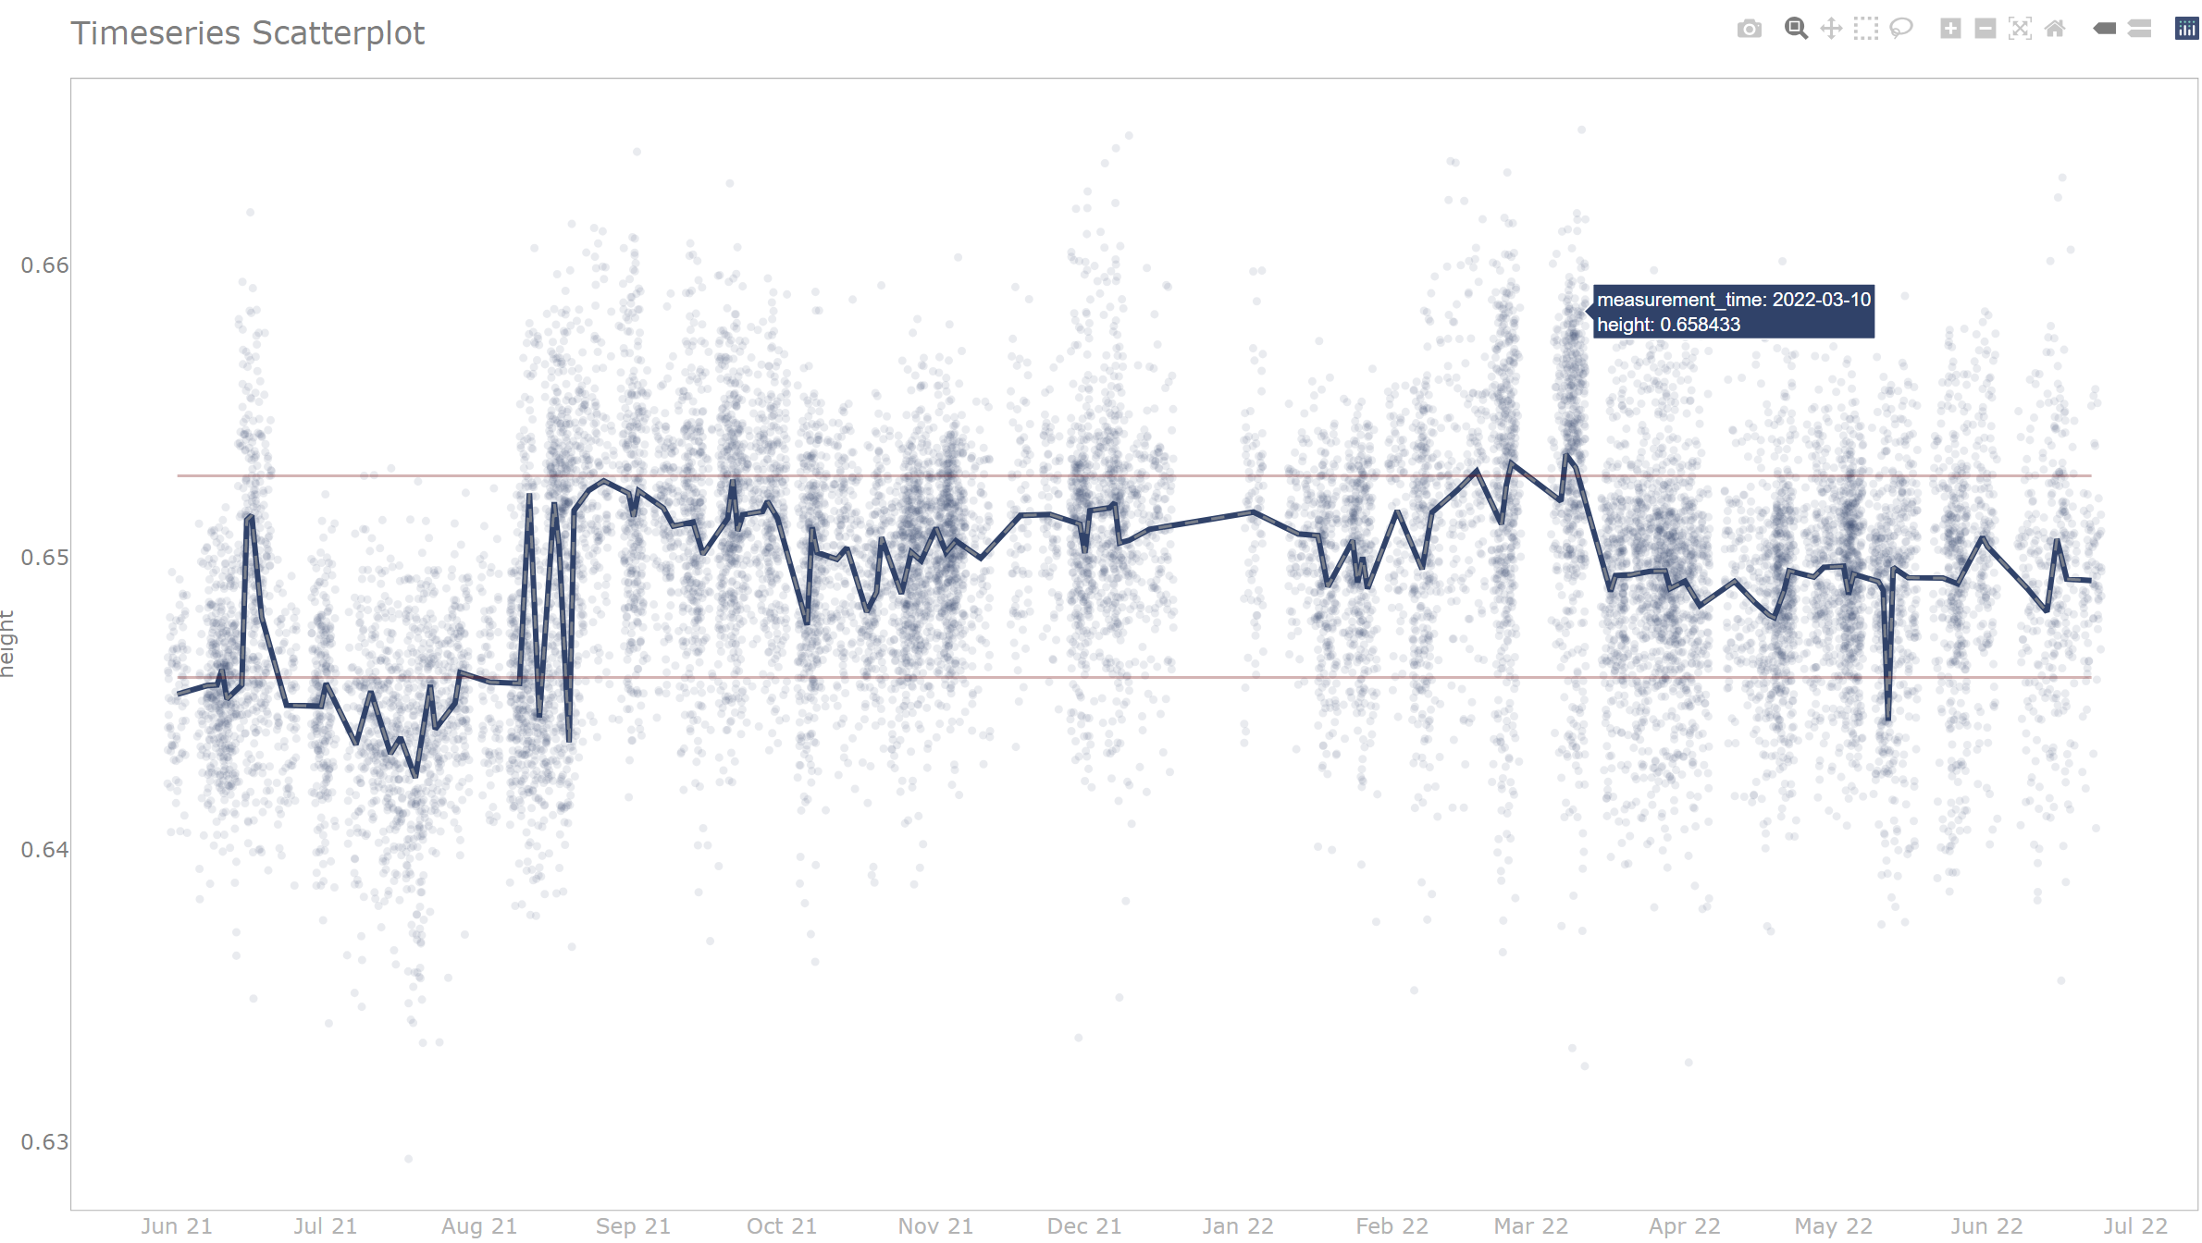
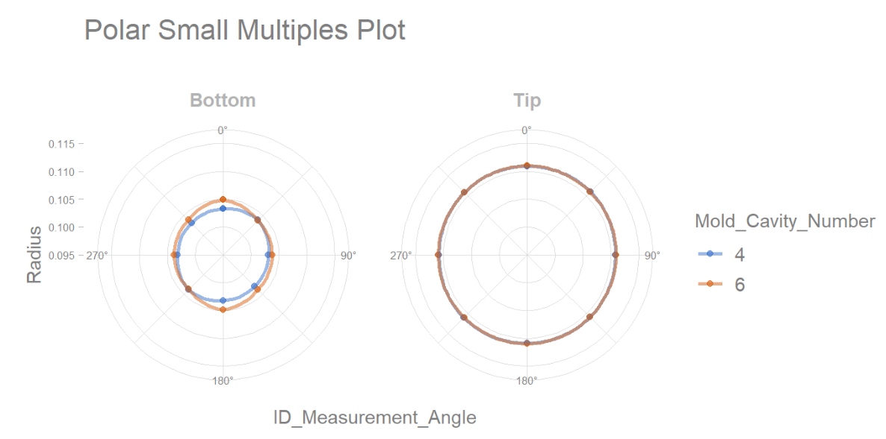
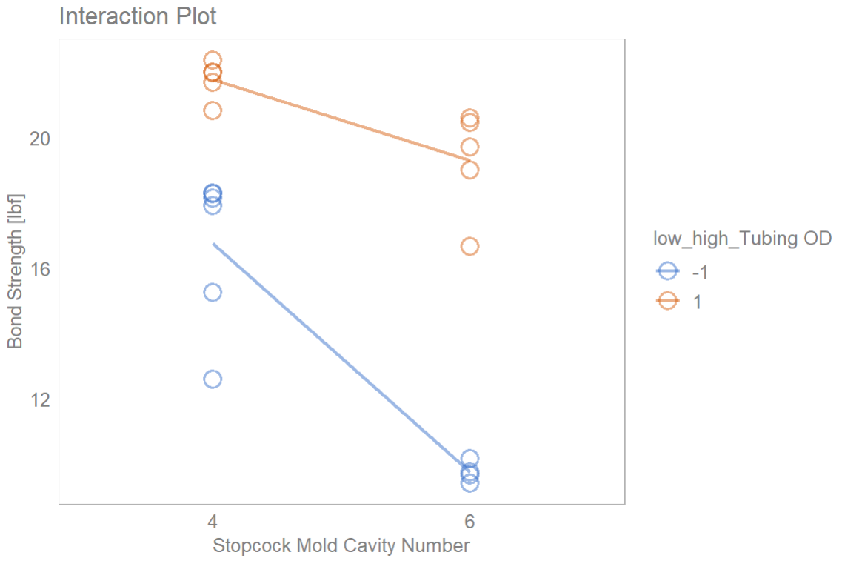
Intro to {sherlock}: an R Package for Problem Diagnosis
by Gabor Szabo
SoCal RUG, April 18th, 2023

Slide 2
About Gabor Szabo
Sr. Principal Engineer, Operations Excellence at Edwards Lifesciences
17 years of experience in engineering (quality and manufacturing)
Bachelors in Engineering Management
Have used R for 2 years
Data analysis
Shiny
Package development: sherlock
Taught fundamentals of R programming at Edwards Lifesciences
R for Engineering newsletter on LinkedIn

Slide 3
From Excel to R to package development
Data analysis has always been my strong suit
Built custom applications in Excel
Tried to learn Python with no luck – haven’t given up yet
Stumbled upon R two years ago – love at first sight
Decided to build a set of functionality for my own use
The idea of a package
Development and submission

Slide 4
sherlock
Provides graphical and statistical tools for diagnosis of manufacturing-related problems
Small multiples types of visuals
Typically small datasets from experiments
Target audience: engineers who are tasked with diagnosing quality or performance-related problems of products, machines or processes existing in the physical world
Has been on CRAN since November 2022. Current version is 0.6.0

Slide 5


Product Quality and Reliability
Important product characteristics
Customer level: safe, affordable, reliable, comfortable, attractive
Manufacturer level: form, fit, function
Variation is the enemy
Raw materials, components
Processing
Environment

Slide 6
Product Quality and Reliability
Proactive
Product quality and reliability
Problems prevented
Robust design (quality and reliability “designed in”)
Reactive
Deviation from specified conditions
Problem needing resolution
Problem diagnosis – problem solving
Why did this problem occur?
What drives variation in an important product characteristic?

Slide 7
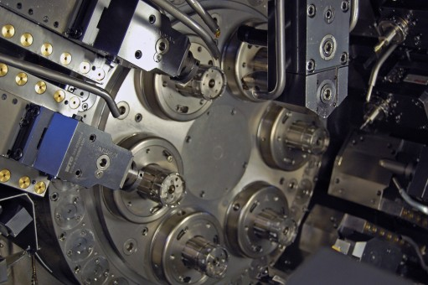
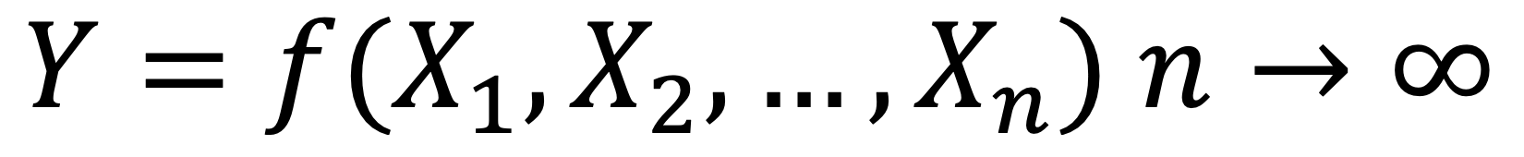
Causality in Manufacturing
Deterministic: laws of physics apply. Energy transformation.
Sparsity of effects: tells us that any effect cannot be evenly attributed to a large number of variables¹.
Measured Values of a Product Characteristic (Y)
Variation in Parts
Variation in Measurements (Y)
+
+
+
+
+
+
Repeatability
Reproducibility
X₁₇
X₃
X₆
X₂
X₁₁
X₁
X₂₀
Dominant X
¹Diagnosing Performance and Reliability, David J. Hartshorne and The New Science of Fixing Things, 2019

Slide 8
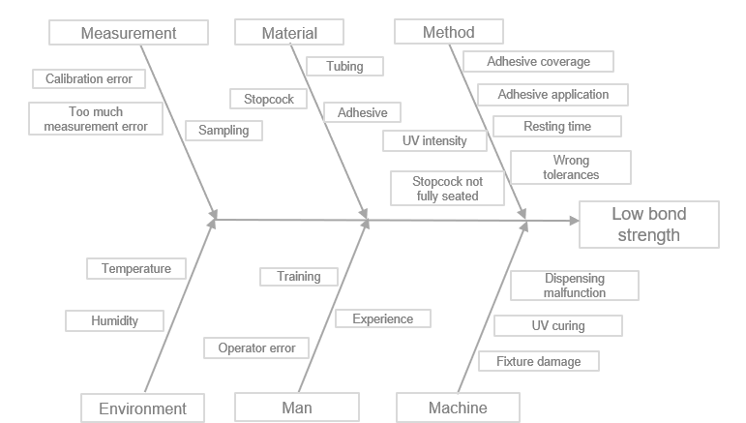
Diagnostic Approaches
Fishbone - Brainstorming
Hypothesis generators based on brainstorming and some amount of existing knowledge. The goal of a Fishbone exercise is to consider the potential impact of as many variables (Xs) as possible that we already know about or can think of. This approach, however, is not effective and is definitely not efficient.
Testing the effect of each of the potential variables may be possible, but most of it would be a waste of time and resources
Since these potential variables (Xs) are usually the result of brainstorming, a lot of times what we are searching for is not even on the list!
Consider how long it would take us to test the effect all of these potential causes; several weeks, if not months! We simply don’t have that much time.
What’s wrong?

Slide 9
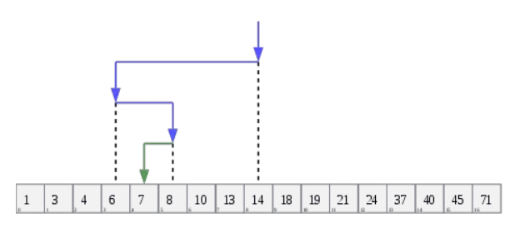
Diagnostic Approaches
Progressive search – Process of Elimination
In a progressive search, you start from the Y and converge on the X through posing and answering a series of questions
The questions must be phrased carefully so that all possibilities not yet eliminated are included thereby progressively reducing the search space – think binary search
What’s different?

Slide 10
Diagnostic Approaches
Search Tree
What drives variation in bond strength?
Measurements
Parts
Elemental Variation
Higher Family Group
Cyclical Variation
Higher Family Group
Stopcock and tubing
Inputs
Components
Function
Bonding process
Structural Variation
Temporal Variation
Stopcock inner cylindrical geometry: shape slightly elliptical at the bottom for cavities 5 and 6
Stopcock
Tubing
Interference of stopcock ID and tubing OD
Interaction
Stopcock-Tubing

Slide 11
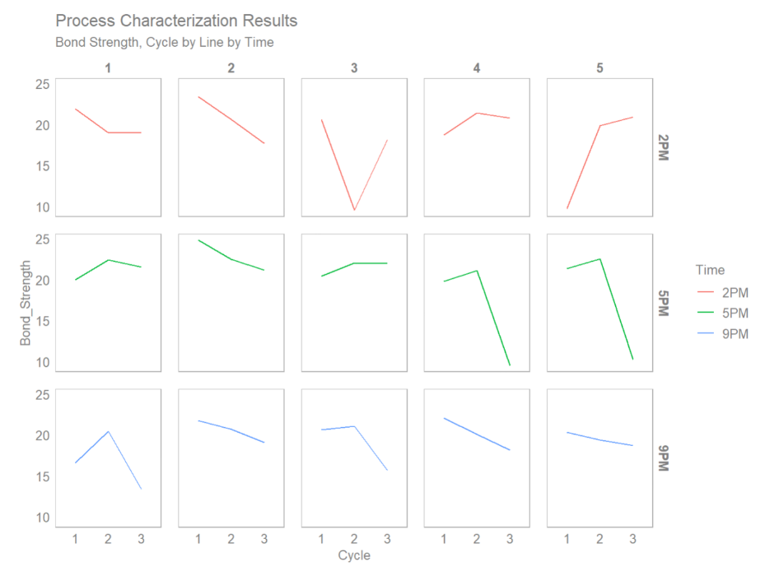
Small Multiples
Data visualization technique
Coined by data visualization pioneer and educator Edward Tufte
Instead of plotting all observations from a dataset in the same space, they are grouped and displayed in separate smaller displays using the same axes and scale
Small multiples are codename for faceting in ggplot2
“That is to say, nature’s laws are causal; they reveal themselves by comparison and difference, and they operate at every multi-variate space-time point” - Edward Tufte
What’s different?

Slide 12
sherlock - basic workflow
Simplicity
Import data
Data cleaning / transformation
Plotting data
Report
Data transformation

Slide 13
Functionality

Slide 14
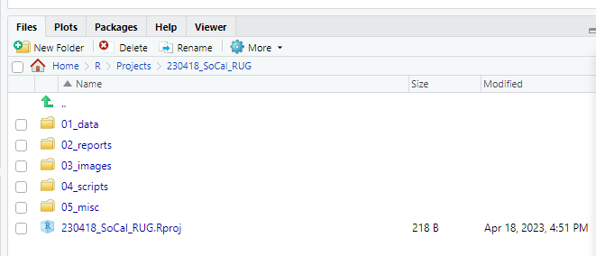
sherlock::create_project_folder()
Helper function for setting up a project folder

Slide 15
sherlock::load_file(), load_files()
Wrapper functions around common functions for reading in .xlsx, .txt and .csv files
The ability to read in and clean multiple files (integration with a custom data cleaning function)

Slide 16
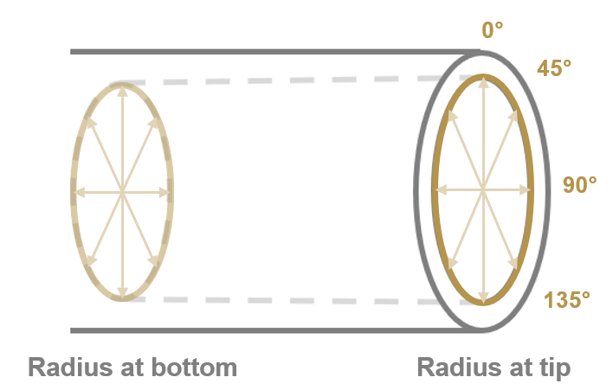
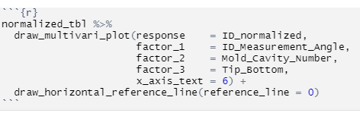
sherlock::draw_multivari_plot()
Small multiples plot
Takes a dataframe that includes the Y characteristic of interest and levels (groups) of X variables and outputs a multivari plot
Can handle up to 3 levels (groups)
Can be used with other helper functions such as draw_horizontal_reference_line() or normalize_observations()
ID at bottom
ID at tip

Slide 17
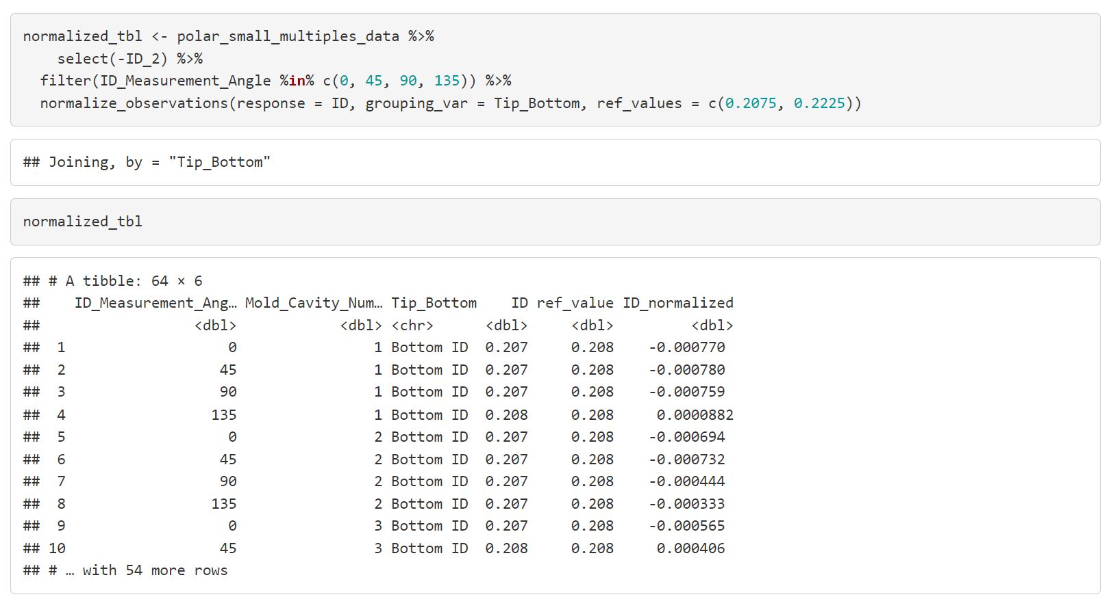
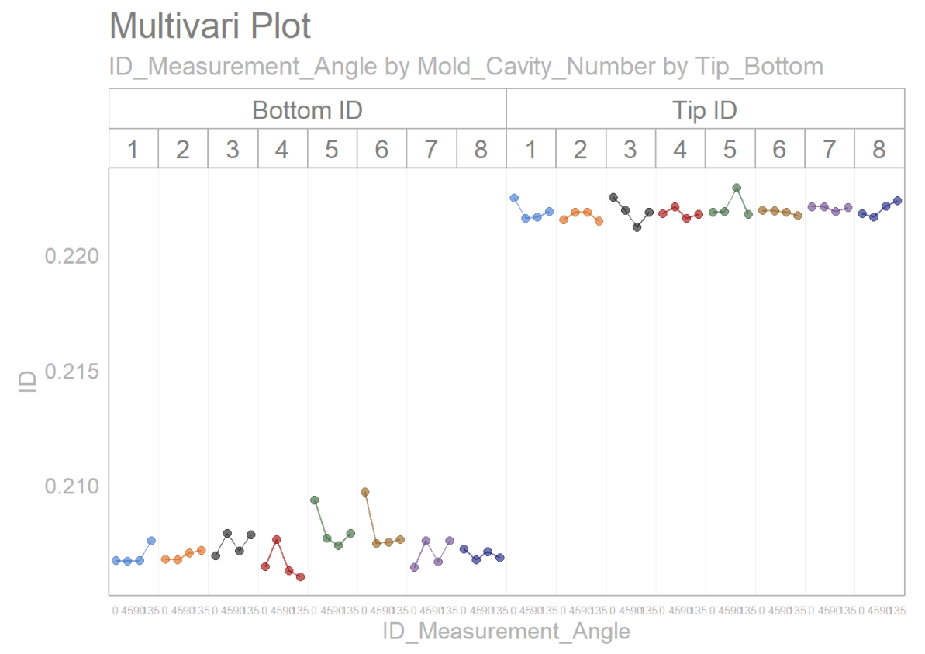
sherlock::normalize_observations()
Normalizing observations can be helpful to show deviation from an expected value, especially when multiple groups, each having a different expected value, are being plotted
Takes a dataframe and outputs a dataframe adding a column with observations normalized for the Y characteristic of interest
The new dataframe with the normalized values can then be plotted
Creates new column with normalized values
ID at bottom
ID at tip
You can easily turn this…
…into this!

Slide 18
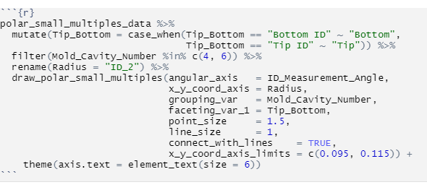
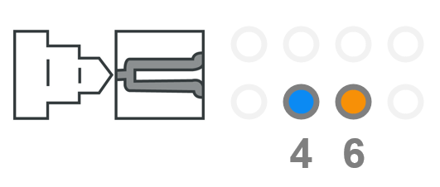
sherlock::draw_polar_small_multiples()
Useful for plotting rotational or cylindrical data to understand shape or positional deviations
Information carried on the parts as to how their geometry is created¹
Example 1: Shape of the inner cylinder of an injection molded component
¹Diagnosing Performance and Reliability, David J. Hartshorne and The New Science of Fixing Things, 2019

Slide 19
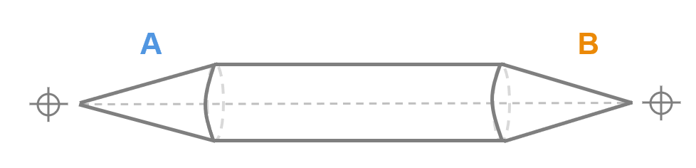
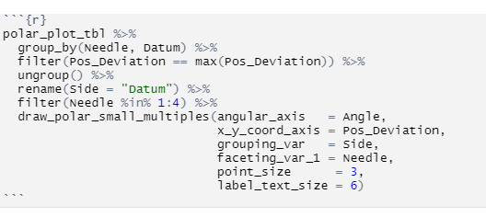
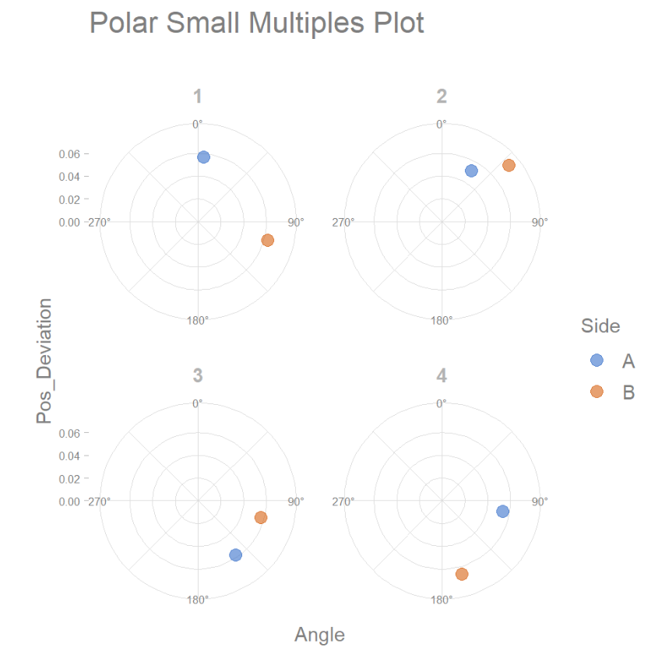
sherlock::draw_polar_small_multiples()
Example 2: Positional deviation of the two tips of a long, cylindrical component

Slide 20
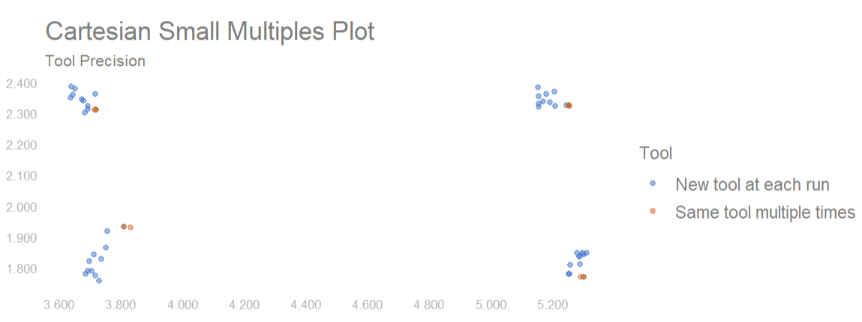
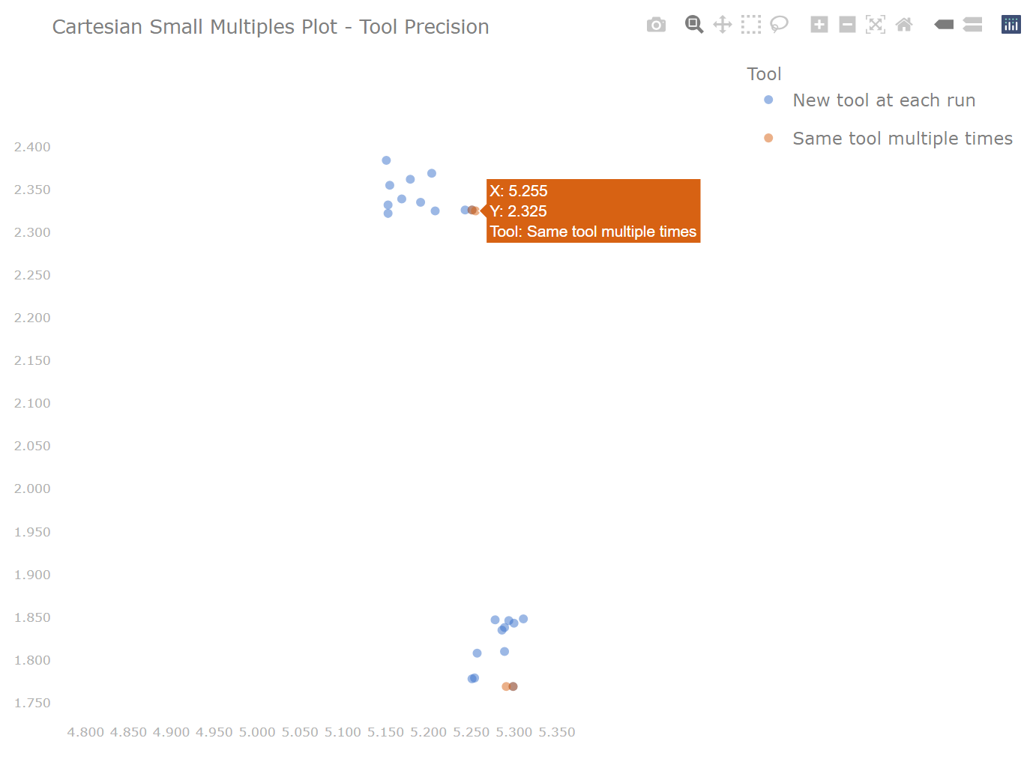
sherlock::draw_cartesian_small_multiples()
A powerful plot for visualizing data in a cartesian coordinate system (x-y)
Custom grouping and faceting
Full interactivity (built-in Plotly view)
Interactive Plotly Plot
Static Plot

Slide 21
sherlock::draw_interaction_plot()
Used to visualize two-way interactions
Displays both main effects (means) and individual values

Slide 22
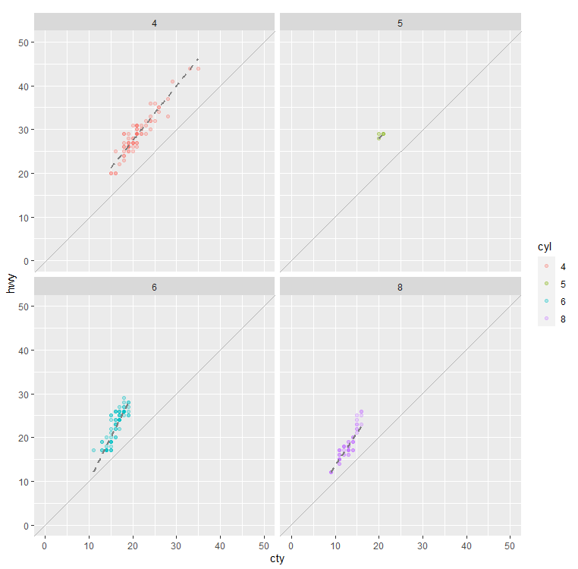
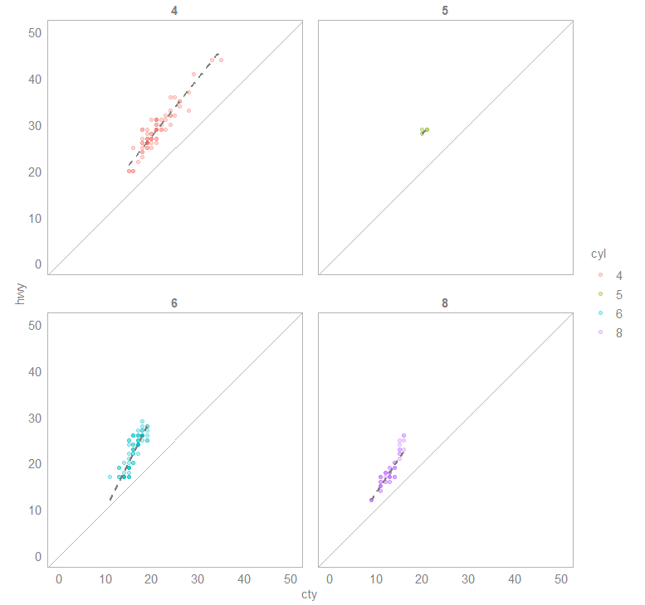
sherlock::theme_sherlock()
Default
theme_sherlock()

Slide 23
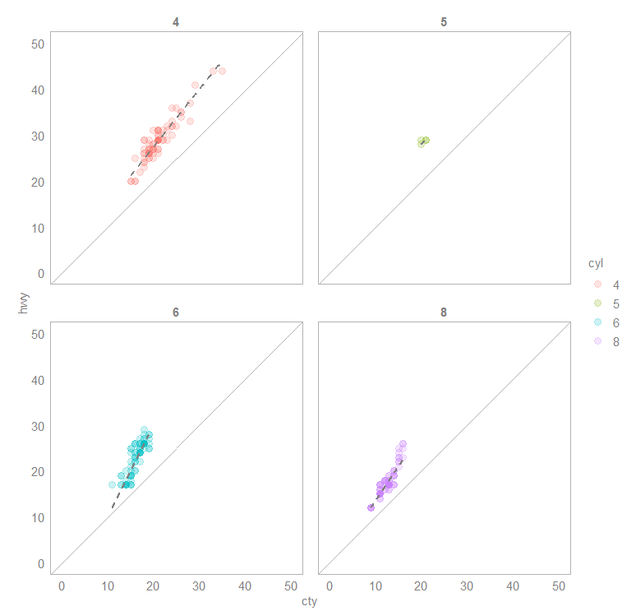
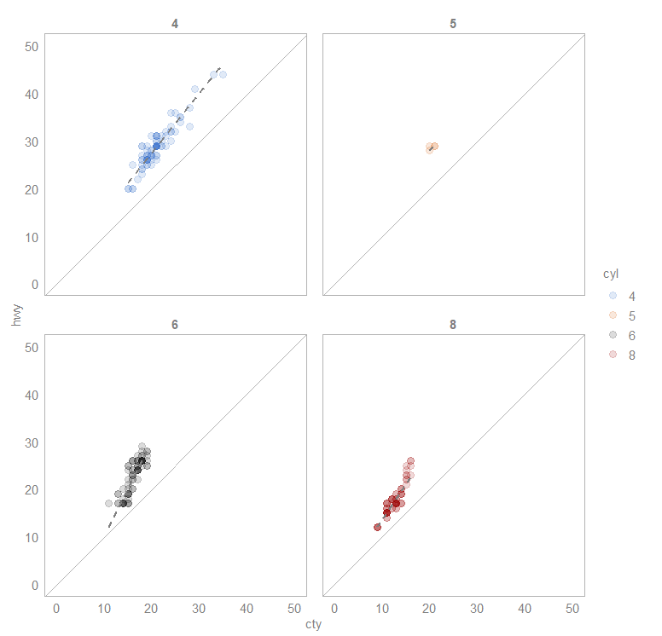
sherlock::scale_color_sherlock(), scale_fill_sherlock()
Default
scale_color_sherlock()

Slide 24
Package Development

Slide 25
Package development
Always design with the end user in mind
Standard argument naming conventions
Y variable
Grouping variables
Faceting variables
Aesthetics (color, alpha, size etc.)
Labels (x, y axis, subtitle etc.)
Interactive: Boolean
It is a software development project, and you are the developer, project manager, tester, technical writer, marketing specialist

Slide 26
Thank you for your attention!
Connect with me on LinkedIn
install.packages(“sherlock”)
https://github.com/gaboraszabo/sherlock
https://gaboraszabo.github.io/sherlock

